Slide 1
Object methods, built-in objects
by Taras Boichuk

Slide 2
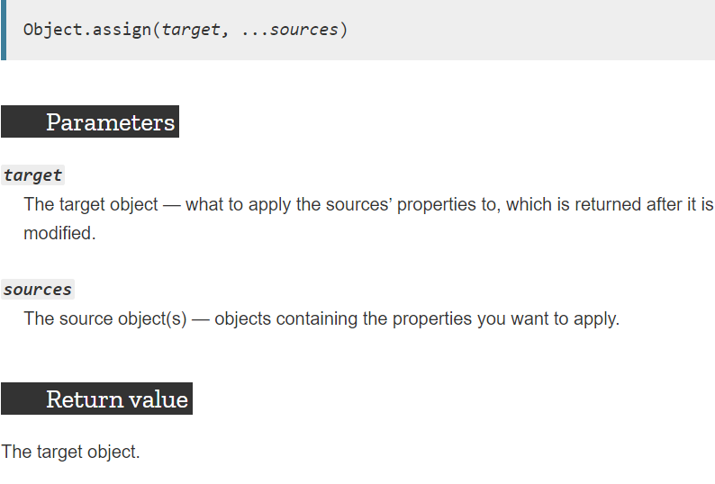
Object.assign()
The Object.assign() method copies all enumerable own properties from one or more source objects to a target object. It returns the target object.
ч

Slide 3
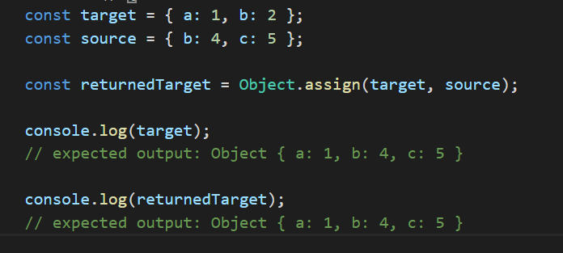
EXAMPLE
ч

Slide 4
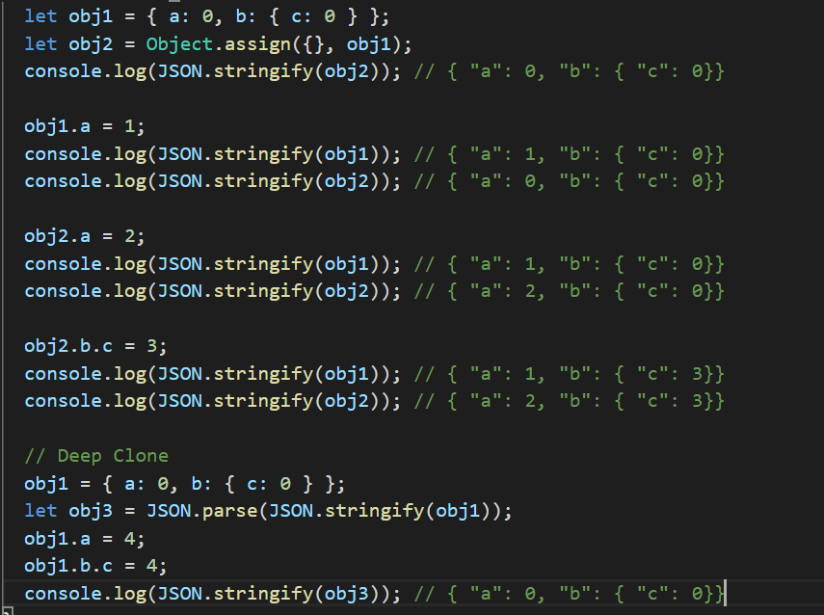
Warning for Deep Clone
ч

Slide 5
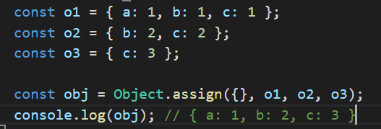
Merging objects with same properties
The properties are overwritten by other objects that have the same properties later in the parameters order.

Slide 6
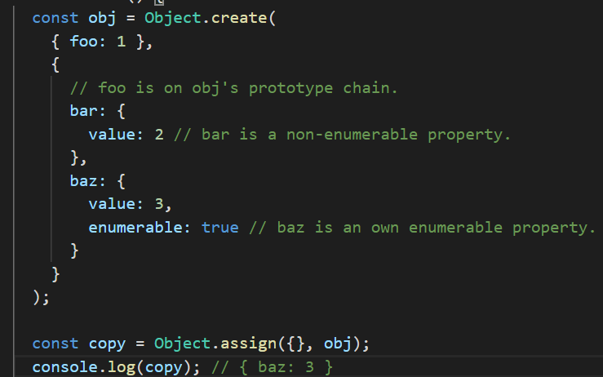
Properties on the prototype chain and non-enumerable properties cannot be copied

Slide 7
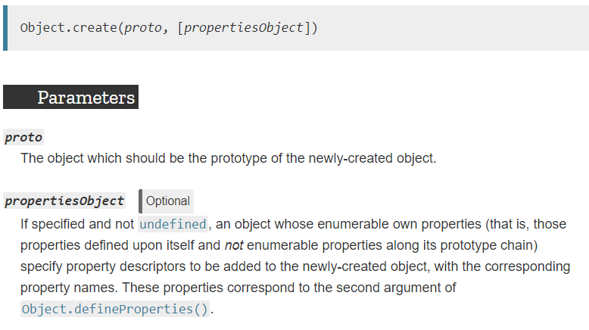
Object.create()
The Object.create() method creates a new object, using an existing object as the prototype of the newly created object.
The Object.create() method creates a new object, using an existing object as the prototype of the newly created object.
Notes:
Выбрасывает исключение TypeError, если параметр proto не является null или объектом.

Slide 8
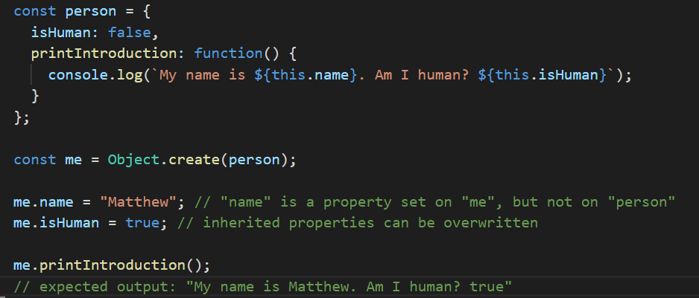

Slide 9
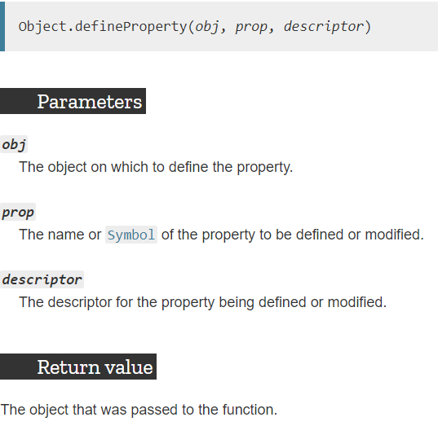
Object.defineProperty()
The static method Object.defineProperty() defines a new property directly on an object, or modifies an existing property on an object, and returns the object.

Slide 10
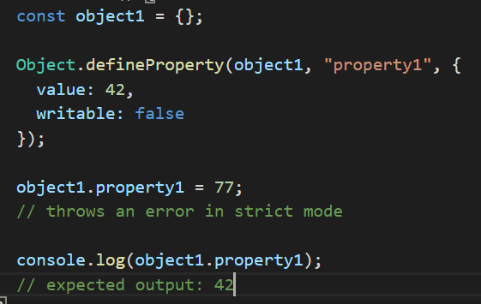

Slide 11
Descriptors
configurable
enumerable
value get
writable set
||

Slide 12
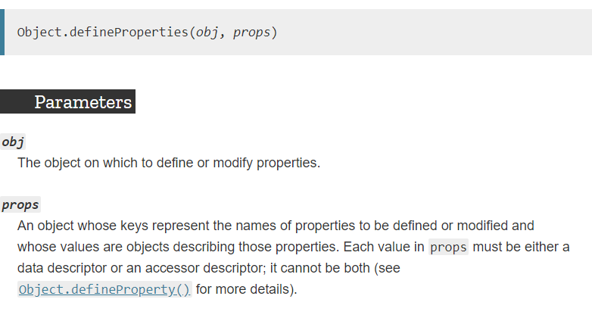
Object.defineProperties()

Slide 13
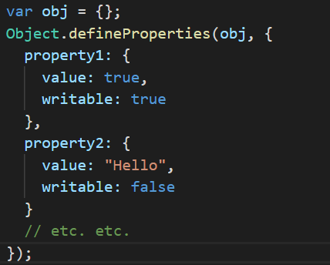
Object.defineProperties()

Slide 14
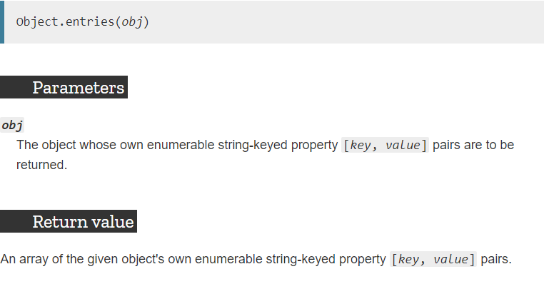
Object.entries()
The Object.entries() method returns an array of a given object's own enumerable string-keyed property [key, value] pairs

Slide 15
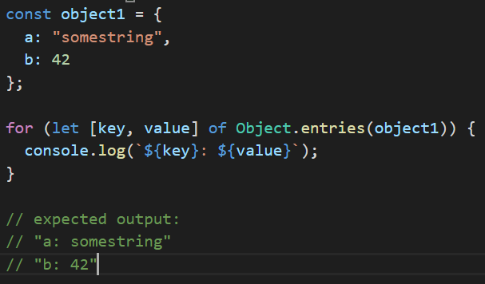

Slide 16
Object.keys() & Object.values()
These methods returns an array of a given object's own enumerable property values or keys

Slide 17
Object.freeze()
The Object.freeze() method freezes an object. A frozen object can no longer be changed; freezing an object prevents new properties from being added to it, existing properties from being removed, prevents changing the enumerability, configurability, or writability of existing properties, and prevents the values of existing properties from being changed. In addition, freezing an object also prevents its prototype from being changed. freeze() returns the same object that was passed in.
Notes:
Ніщо не може бути додане чи видалене з набору властивостей замороженого об'єкта. Будь-яка спроба це зробити зазнає невдачі, або непомітно, або з викиданням винятку TypeError (найчастіше, але не винятково, у строгому режимі).
Для властивостей-значень замороженого об'єкта не можна змінювати значення, атрибутам writable та configurable встановлено значення false. Властивості-аксесори (гетери та сетери) працюють, як і раніше (і так само створюють ілюзію, що ви міняєте значення). Зауважте, що значення, які є об'єктами, можна змінювати, якщо тільки вони теж не заморожені. Масив, як об'єкт, може бути заморожений; після цього його елементи не можуть бути змінені, і жоден елемент не може бути доданий чи видалений з масиву.
freeze() повертає той самий об'єкт, який був переданий у функцію. Він не створює заморожену копію.

Slide 18
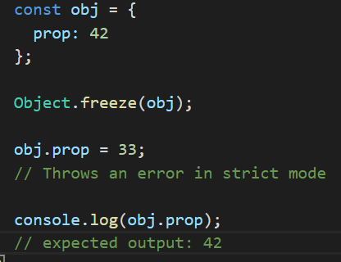
Nothing can be added to or removed from the properties set of a frozen object. Any attempt to do so will fail, either silently or by throwing a TypeError exception (most commonly, but not exclusively, when in strict mode).

Slide 19
Object.seal()&Object.preventExtensions()
The Object.seal() method seals an object, preventing new properties from being added to it and marking all existing properties as non-configurable. Values of present properties can still be changed as long as they are writable
The Object.preventExtensions() method prevents new properties from ever being added to an object (i.e. prevents future extensions to the object).
Notes:
На цій сторінці
Синтаксис
Опис
Приклади
Примітки
Специфікації
Сумісність з веб-переглядачами
Див. також
Метод Object.seal() запечатує об'єкт, запобігаючи створенню нових властивостей та відмічаючи усі існуючі властивості як недоступні для налаштування. Значення існуючих властивостей можна і надалі змінювати, якщо вони доступні для запису.

Slide 20
Let check if our object is restricted
Object.isFrozen(obj)
Determines if an obj t was frozen.
Object.isSealed(obj)
Determines if an obj is sealed.
Object.isExtensible()
determines if an object is extensible (whether it can have new properties added to it).

Slide 21
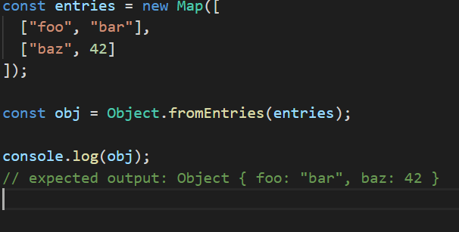
Object.fromEntries()

Slide 22
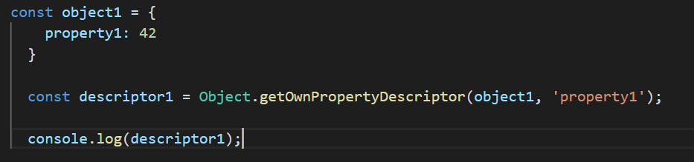
Object.getOwnPropertyDescriptor()
The Object.getOwnPropertyDescriptor() method returns a property descriptor for an own property (that is, one directly present on an object and not in the object's prototype chain) of a given object.

Slide 23
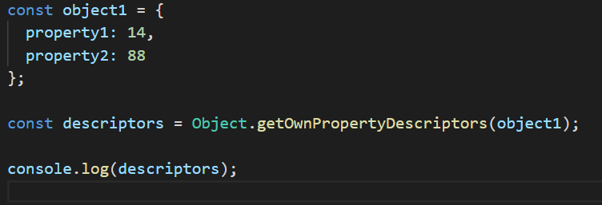

Object.getOwnPropertyDescriptors()
The Object.getOwnPropertyDescriptors() method returns all own property descriptors of a given object.
The Object.getOwnPropertyDescriptors() method returns all own property descriptors of a given object.
The Object.getOwnPropertyDescriptors() method returns all own property descriptors of a given object.

Slide 24
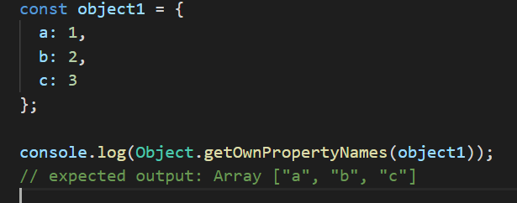
Object.getOwnPropertyNames()
The Object.getOwnPropertyNames() method returns an array of all properties (including non-enumerable properties except for those which use Symbol) found directly in a given object.

Slide 25
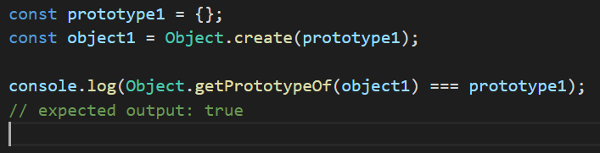
Object.getPrototypeOf()
The Object.getPrototypeOf() method returns the prototype (i.e. the value of the internal [[Prototype]] property) of the specified object.

Slide 26
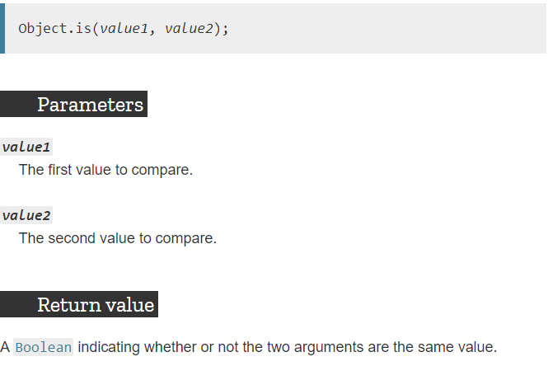
Object.is()
The Object.is() method determines whether two values are the same value.
*This is also not the same as being equal according to the === operator. The === operator (and the == operator as well) treats the number values -0 and +0 as equal and treats Number.NaN as not equal to NaN.

Slide 27
Built-in objects
- Built-in objects are not related to any Window or DOM object model.
- These objects are used for simple data processing in the JavaScript.

Slide 28
Value properties
These global properties return a simple value. They have no properties or methods.
- Infinity
- NaN
- undefined
- globalThis

Slide 29
Fundamental objects
These are the fundamental, basic objects upon which all other objects are based. This includes general objects, booleans, functions, and symbols.
- Object
- Function
- Boolean
- Symbol

Slide 30
Numbers and dates
These are the base objects representing numbers, dates, and mathematical calculations
- Number
- BigInt
- Math
- Date

Slide 31
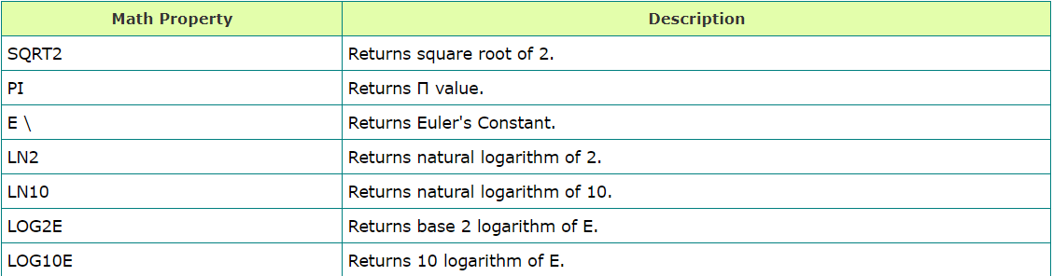
Math Object
Math Properties

Slide 32
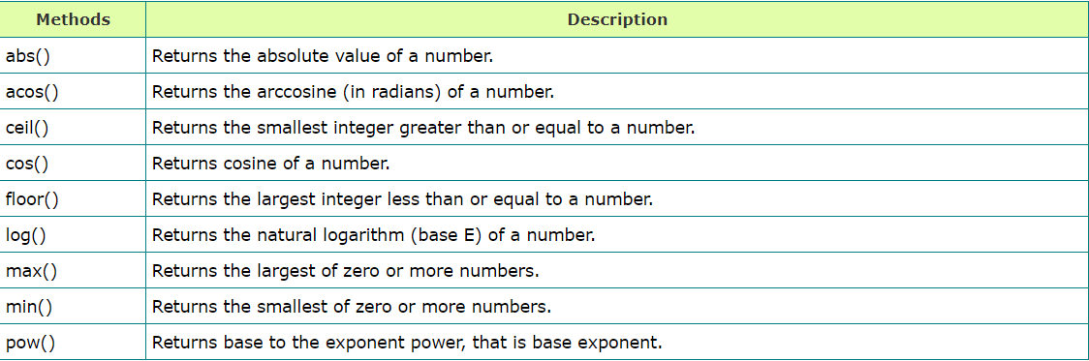
Math Object
Math Methods

Slide 33
Date Object
Date is a data type.
Date object manipulates date and time.
Date() constructor takes no arguments.
Date object allows you to get and set the year, month, day, hour, minute, second and millisecond fields.

Slide 34
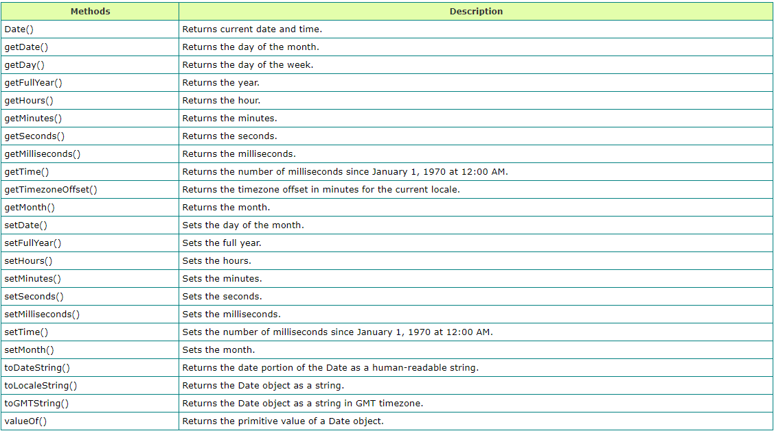

Slide 35
USED LINKS
https://www.tutorialride.com/javascript/javascript-built-in-objects.htm
https://developer.mozilla.org/en-US/docs/Web/JavaScript/Reference/Global_Objects/
https://developer.mozilla.org/ru/docs/Web/JavaScript/Reference/Global_Objects/Object

